Slide 1
FUNDAMENTALS OF RESERVOIR FLUID FLOW
The primary reservoir characteristics that must be considered include:

Slide 2
TYPES OF FLUIDS

Slide 3
Incompressible Fluids

Slide 4
Slightly Compressible Fluids

Slide 6
Compressible Fluids

Slide 7
FLOW REGIMES

Slide 10
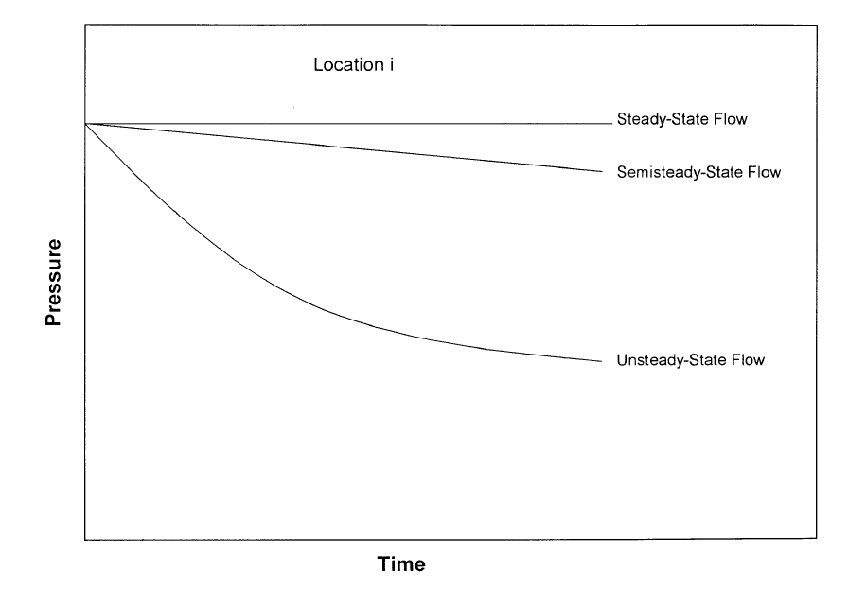
RESERVOIR GEOMETRY

Slide 11
Radial Flow

Slide 12
Linear Flow

Slide 13
Spherical and Hemispherical Flow

Slide 14
NUMBER OF FLOWING FLUIDS IN THE RESERVOIR

Slide 15
Darcy’s Law
For a horizontal linear system,
For a horizontal-radial system

Slide 16
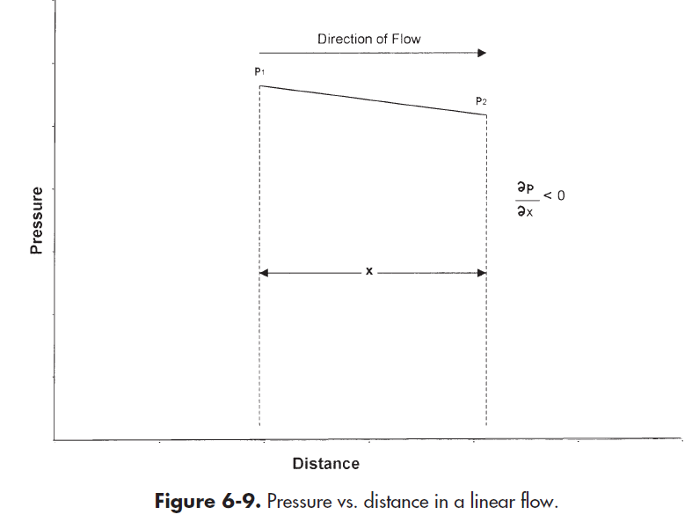
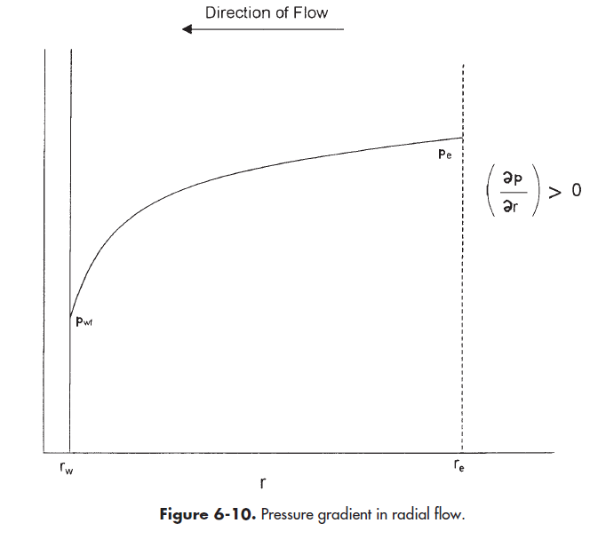

Slide 17
STEADY-STATE FLOW

Slide 18
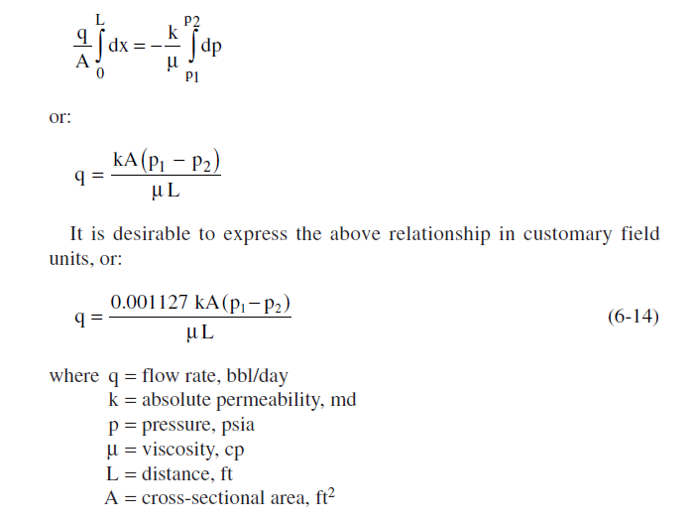
Linear Flow of Incompressible Fluids

Slide 22
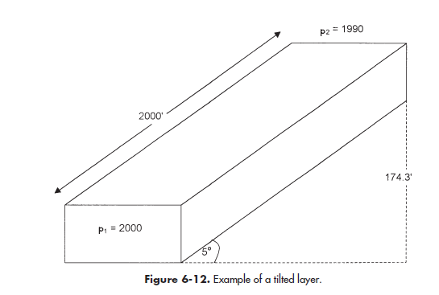

Slide 23
